Slide 1
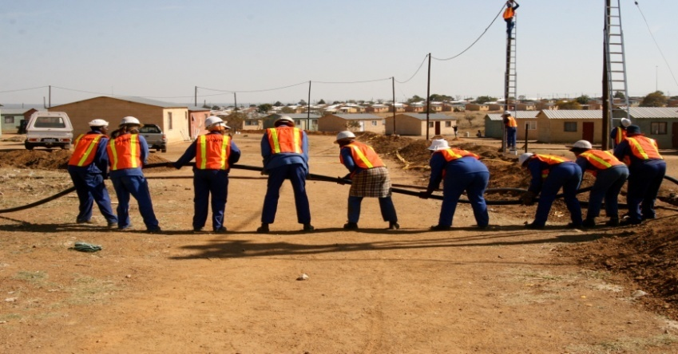
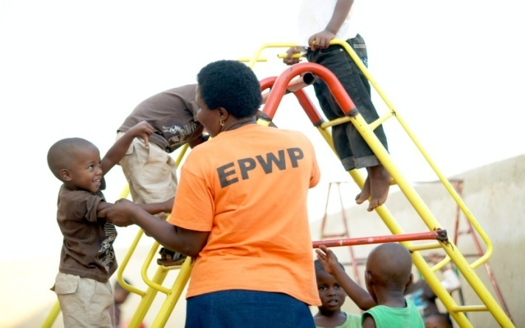
Expanded Public Works Programme (EPWP) Phase 3 Deputy Minister Jeremy Cronin Presentation to 4th EPWP Summit 27th November 2014

Slide 2
BACKGROUND OF EPWP

Slide 3
EPWP Phase 1 (2004-2009)
In late 1990s and early 2000s – economic growth, but persisting crisis levels of unemployment. In this context, following the 2003 Growth and Development Summit, Government agreed on a massification of the public works programme – EPWP phase 1 with a 5-year target of 1 million work opportunities.
The key assumption (at the time) was economic growth in the “first economy” was not impacting upon the “second economy” – hence the need for targeted developmental programmes (SMME Development, Taxi Recapitalization Project and EPWP) as once-off ladders to “graduate” “second economy” activities into “formal economy”.
Phase 1 achieved its 1 million work opportunities target one-year ahead (2008) of schedule – but unemployment remained stubbornly high, and worsened from 2008 – with onset of global economic crisis.

Slide 4
EPWP Phase 2 – (2009-2014)
Encouraged by success of massification in Phase 1 (1 million work opportunities in
4 years), and responding to local job-loss crisis linked to global economic crisis – Phase 2
set an ambitious 4,5 million work opportunities target.
By end of March 2014 we had achieved 4,3 m work opportunities.
Phase 2 has also seen new developments – including: introduction of the Non-State sector, which has two programmes, namely Community Work Programme and Non-Profit Organisation programme, and the National, Provincial and Municipal EPWP Incentive.
Government’s New Growth Path policy (2010) clearly broke with “first” and “second” economy paradigm – it’s the MAINSTREAM economy that has systemic challenges.

Slide 5
South Africa a Global Innovator in PEPs
With chronic unemployment, even in many developed economies, the scale and innovative achievements of SA’s PEPs have attracted international interest. However, we have not sufficiently communicated these achievements at home!
Uniquely, our PEPs cut across several sectors. They are championed through different line departments, provinces and municipalities and they have both a rural and urban focus.
Labour intensive methods are mainstreamed into Government infrastructure contracting rather than having PEPs operating in separate silos.

Slide 6
South Africa a Global Innovator in PEPs … continued
SA has been a global pioneer in applying PEPs on scale to environmental services – Working for Water (WfW), Working on Fire, Working for Wetlands, People & Parks
The WfW has cleared over 2 million hectares of alien invasive plants, and prevented loss of 71% of grazing. Also connected to Eco-Furniture Programme – using wood from alien invasives – 500,000 school desks for disadvantaged schools by end of 14/15 financial year
Working on Fire in 2007/2008 saved the forestry industry alone R3,7 billion – on a budget of R123 million.
HUGE CONTRIBUTION TO OUR GDP – BUT NOT CALCULATED IN GDP

Slide 7
Key Lessons from EPWP Phases 1 & 2

Slide 8
Lesson 1: Clarify Key Objective of a Particular Programme The “Trilemma” of PEPs
Sustainable household livelihoods
Provision of Assets & Services
Skills Development & Graduation
PEP’s development potential lies in providing all three of these outcomes- but there are trade-offs between them in practice
For different programmes, sectors and contexts optimal balance between these 3 will vary
Increasing one output… is likely to result in decreases in the others

Slide 9
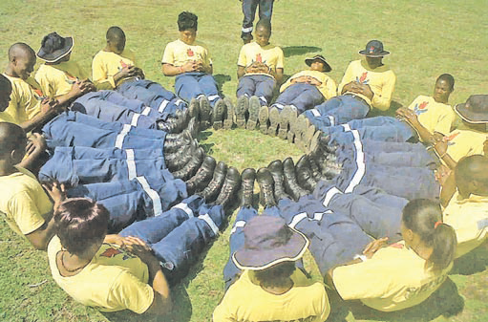
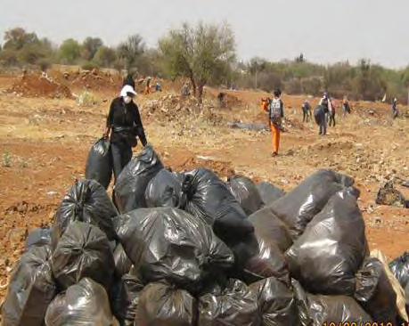
Different strengths of different programmes
Working on Fire – skilled work and training, relatively long term involvement, excellent graduation prospects – but low numbers (5000 fire-fighters p.a.)
Community Work Programme – less training but possibilities to scale-up rapidly to over 1m w/o’s p.a. – contributes to local community cohesion and ownership

Slide 10
Key Lessons from EPWP Phases 1 & 2 … continued
Lesson 2: Achieve better balance between work opportunity headcounts and other outcomes
Work opportunity targets are very important – but we need to balance these with other indicators, including:
Full-time equivalents
Evaluation of post-participation outcomes for participants
Evaluation of assets and services produced
Impact on communities
This will require refining our Monitoring and Evaluation (M&E) capacities

Slide 11
Sustainable livelihoods/A social or solidarity economy? Siyakholwa – forging a different countryside
Siyakholwa Foundation formed 2007 as an NPO. Based in old saw-mill in Qobaqoba, Keiskammahoek.
After trials-and-errors in fostering coops, linked up with government’s CWP.
Now 1,500 participants on stipends working in 37 surrounding villages. Each village has a Village Committee rotating participants and collectively identifying public work in village - home-based care; food gardens supplying free school feeding; maintenance of public facilities in the village (school buildings, the grave-yard, etc.).
Siyakholwa acts as a local implementing agent for the programme, operating in renovated sheds of the old saw-mill. The centre provides training and resourcing for the village food-gardens (soil conservation, composting, seeds); and other skills training – including welding, basic auto-repairs, bee-keeping, and computer literacy.
One of the aims is to train two basic handy-men for all 37 villages.

Slide 15
A co-op in eThekwini metro
Metro’s EPWP programme coordinated by Infrastructure & Socio-Economic Dvpt Dept
I&SE Dept works closely with over 2000 co-ops in metro
One eg: A food garden in Umgeni Valley. 3 pensioners were founders, now have additional coop workers – paid in kind and topped up with cash contribution from pensioners grants!!
Feeds local school, creche and distressed households
3 yrs ago Metro used local EPWP to repair access road – culvert, water pipes, water tanks
Now, because of proven durability – EPWP team building large aqua-culture pond. Metro will provide tilapia, monitor water quality, and provide training

Slide 16
Building sustainable livelihoods A Social/Solidarity Economy
These 2 examples demonstrate that a successful PEP isn’t necessarily about graduation into the formal sector market
Some successful projects don’t shift people out of their villages, or townships, but rather provide a relative de-linking from an often dysfunctional labour market
This can be achieved by working WITH the survival strategies of poor communities (co-ops, stokvels) and by combining a variety of features (even social grants as a top-up – circulating productively within a community rather than going straight out into the pockets of the monopoly finance and retail sector.)

Slide 17
What is a “social economy”?
“The social economy comprises economic activities that are neither run by the state nor by the for-profit private sector. It includes co-ops, burial societies, voluntary and community organizations, community and union investment vehicles, stokvels and community trusts. While they should have positive net returns or break even, their main aim is to meet members’ needs by providing employment, access to savings or goods and services. Their surpluses are used largely for social, environmental and community goals.” (Government’s New Growth Path document)

Slide 18
The potential of a social economy (NGP)
Employment at relatively low cost, high rates of profit are not required, and activities comparatively labour intensive;
Establishing systems for collective ownership of assets, leading to more equitable ownership overall;
Supporting social cohesion – crucial for long-term development
Meeting the basic needs of poor households ;
Providing market services for small and micro-enterprises – through micro-credit associations and marketing co-ops
However, a social economy is not a substitute for transforming the mainstream productive economy

Slide 19
Key Lessons from EPWP Phases 1 & 2 … continued
Lesson 3: Challenges with Infrastructure PEPs
Short-term nature of many infrastructure construction projects
Average work opportunity duration in infrastructure construction and maintenance EPWPs = 65 Days.
Need to place greater emphasis on infrastructure MAINTENANCE – ongoing, local work - Road maintenance programmes like Zibambele and Siyatentela have an average work opportunity duration of 108 days.
Reluctance of private construction sector to use labour intensive approaches
Engage with sector
Ensure training of professionals in labour intensive approaches
Stipulate labour intensive methods more effectively in public sector contracts

Slide 20
Key Lessons from EPWP Phases 1 & 2 … continued
Lesson 4: Mitigate risk of projects being captured for patronage purposes
There are community accusations that the selection of EPWP participants is hijacked by politicians for patronage purposes
Can undermine key developmental outcome forging of community cohesion through collective productive work
Community co-ownership, including community oversight of PEP projects, is the key to averting the risk of clientelism/patronage
The role of community based organisations and other NPOs is proving useful in this regard, in both the CWP and in the EPWP NGO sector

Slide 21
Key Lessons – building a different relationship between the state and communities
Lesson 5: The need to break away from an excessive top-down “service delivery” model of government providing to passive/ angry citizens.
Photo: CWP participants and SAPS members working together to identify crime hot-spots in Kagiso township, Mogale City, West Rand – to develop a joint programme of action

Slide 22
Key Lessons from EPWP Phases 1 & 2 … continued
Lesson 8: The need for much greater co-ordination
The scale, diversity and innovative nature of SA’s PEP programmes = a major achievement…but also a challenge:
More work needs to be done in relation to common branding
Poorly coordinated public communication on achievements across PEP programmes;
insufficient sharing of lessons across programmes; and
insufficient co-ordination between PEPs and other potentially related Government policies, strategies and initiatives – adult education and training; SMME and Co-ops development; sustainable livelihoods; and food security programmes, etc.
This is the key lesson from the past 10 years, and prime reason for the recent Cabinet decision to establish a Presidentially Coordinated IMC for PEPs. First meeting scheduled for next week.

Slide 23
We hope to take the lessons and decisions of this EPWP Summit into next week’s IMC !!
23
Notes:
23

